Slide 1

Compose Input: Text Input and Validation with Android Compose
Presented by
-Rijjul Rubak S A B,
-Arivarasan K,
-Rajeshwari S,
-Ranjitha K.

Slide 2
Project Description
This project demonstrates form validation in an Android app using Jetpack Compose and highlights text input and validation with Kotlin and Java.
Objective: Ensure accuracy in user inputs for applications such as registrations, logins, and data entry forms.

Slide 3
Jetpack Compose Overview
Jetpack Compose is a modern Android UI toolkit that simplifies and accelerates UI development.
Benefits:
- Declarative: Define UI with less code.
- Efficient: Minimizes the need for XML layout files.
- Interoperable: Seamlessly integrates with existing Java code.

Slide 4
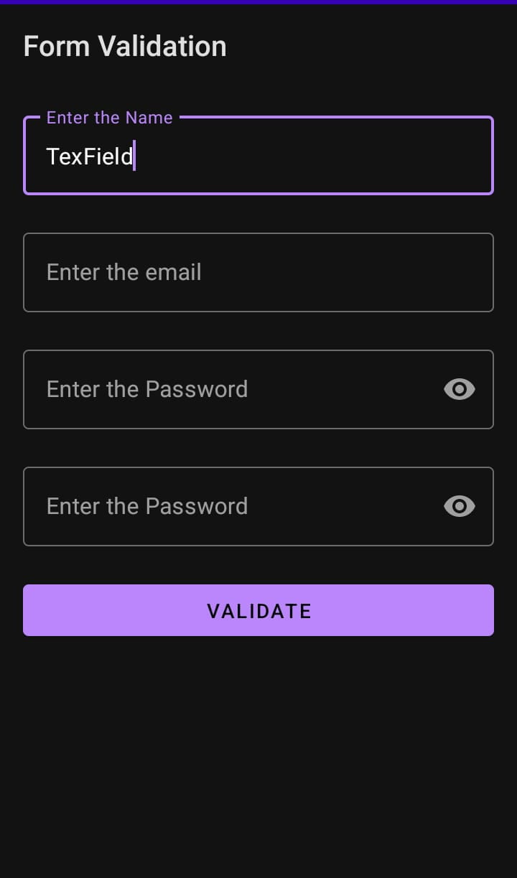
Text Input Components in Compose
Compose Provide ‘TextField’and ‘OutlinedTextField’for user text input
Example (Kotlin):
TextField(
value = text,
onValueChange = { newText -> text = newText },
label = { Text("Enter your text") }
)

Slide 5
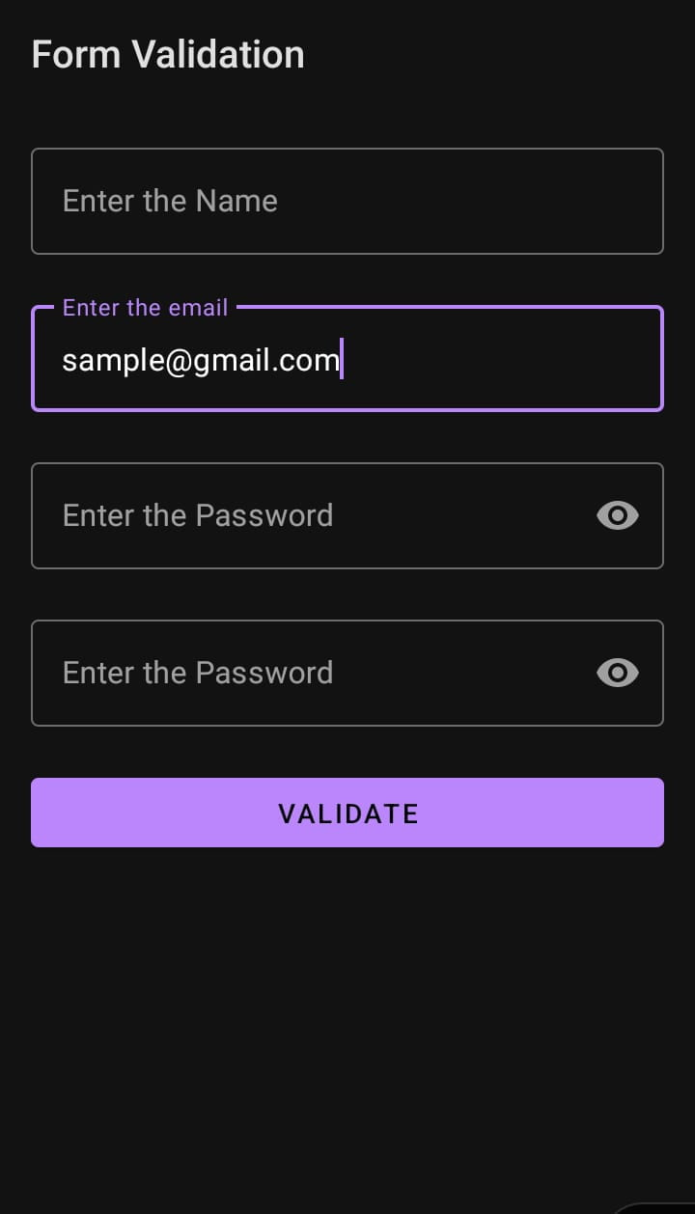
Basic Validation Example in Kotlin
Simple Email Validation
Example:
fun isValidEmail(email: String): Boolean {
return android.util.Patterns.EMAIL_ADDRESS.matcher(email).matches()
}

Slide 6
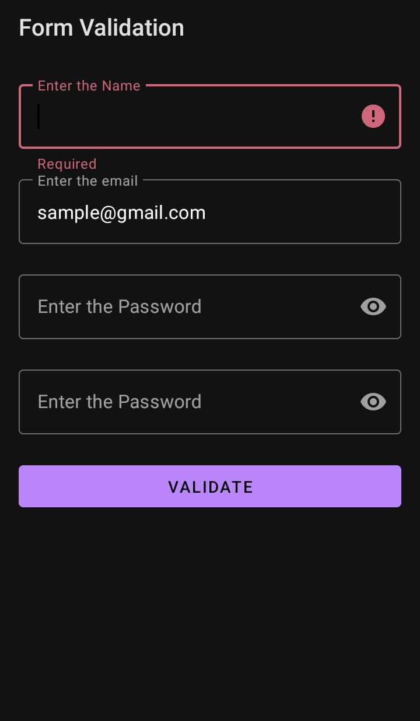
Real-Time Validation Example
Real-Time feedback provides validation while the user type
Example:
var email by remember { mutableStateOf("") }
var isValid by remember { mutableStateOf(true) }
TextField(
value = email,
onValueChange = {
email = it
isValid = isValidEmail(email)
},
label = { Text("Email Address") },
isError = !isValid
)

Slide 7
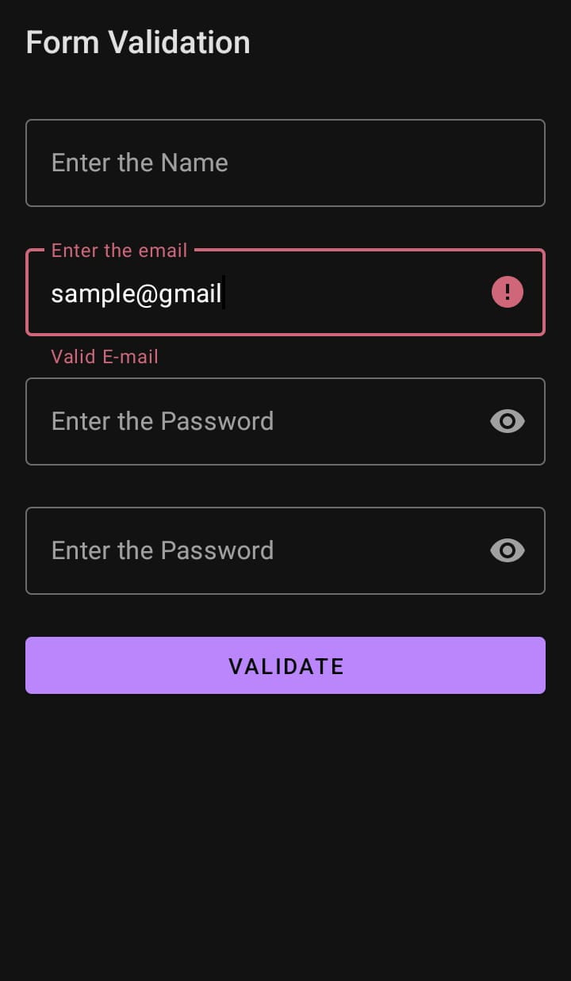
Error Handling and Visual Feedback
Error feedback guides users to correct mistakes.
Example:
if (!isValid) {
Text("Invalid email address", color = Color.Red)
}

Slide 8
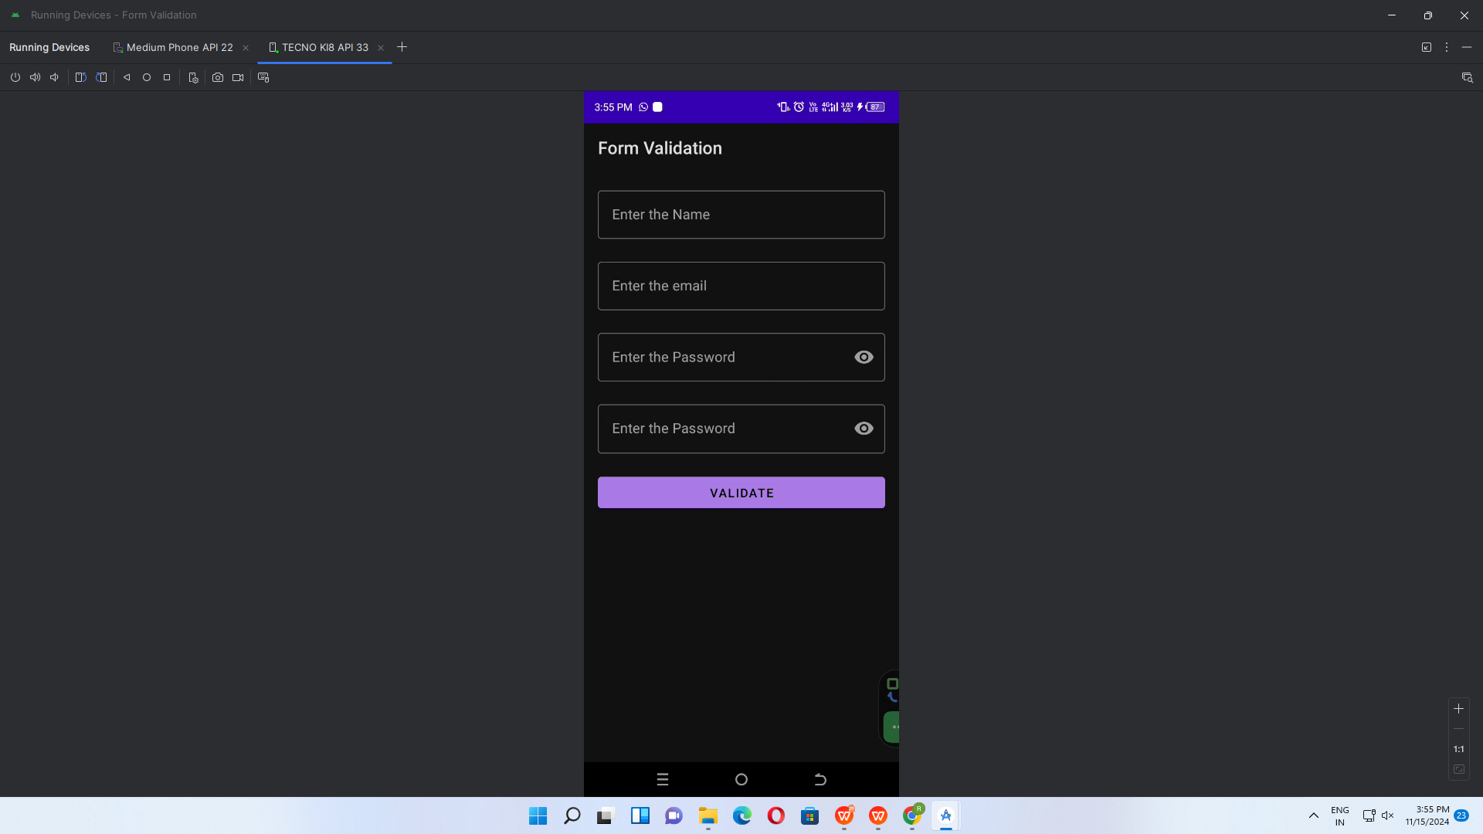
Output

Slide 9
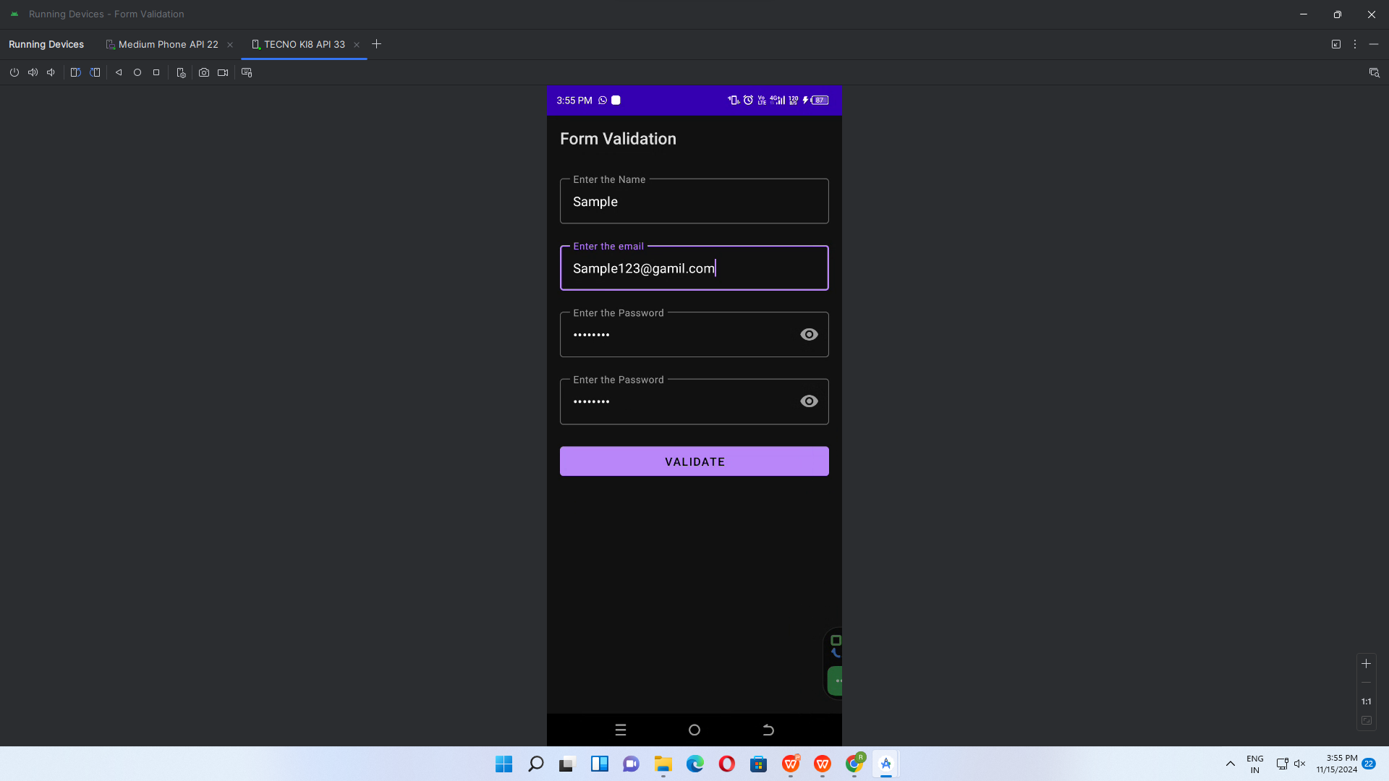

Slide 10
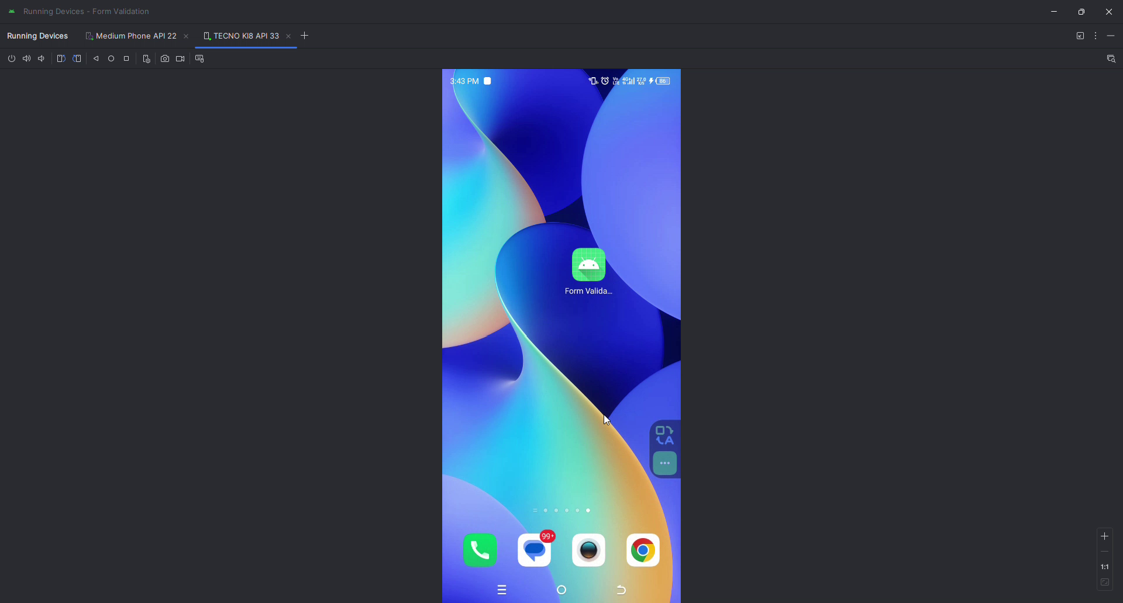

Slide 11
Conclusion
In this presentation, we explored:
- The importance of input validation in Android apps.
- Implementing text input and real-time validation in Jetpack Compose.
- Examples of Kotlin code for email validation.

Slide 12
THANK YOU !

